Slide 1

ANTI HYPERTENSIVE DRUGS
BY
DR.G.AARTHIPRIYANKA
POST GRADUATE
DEPARTMENT OF PHARMACOLOGY
RMMC

Slide 2

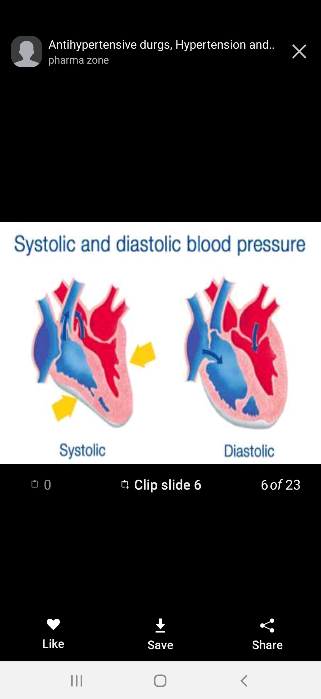
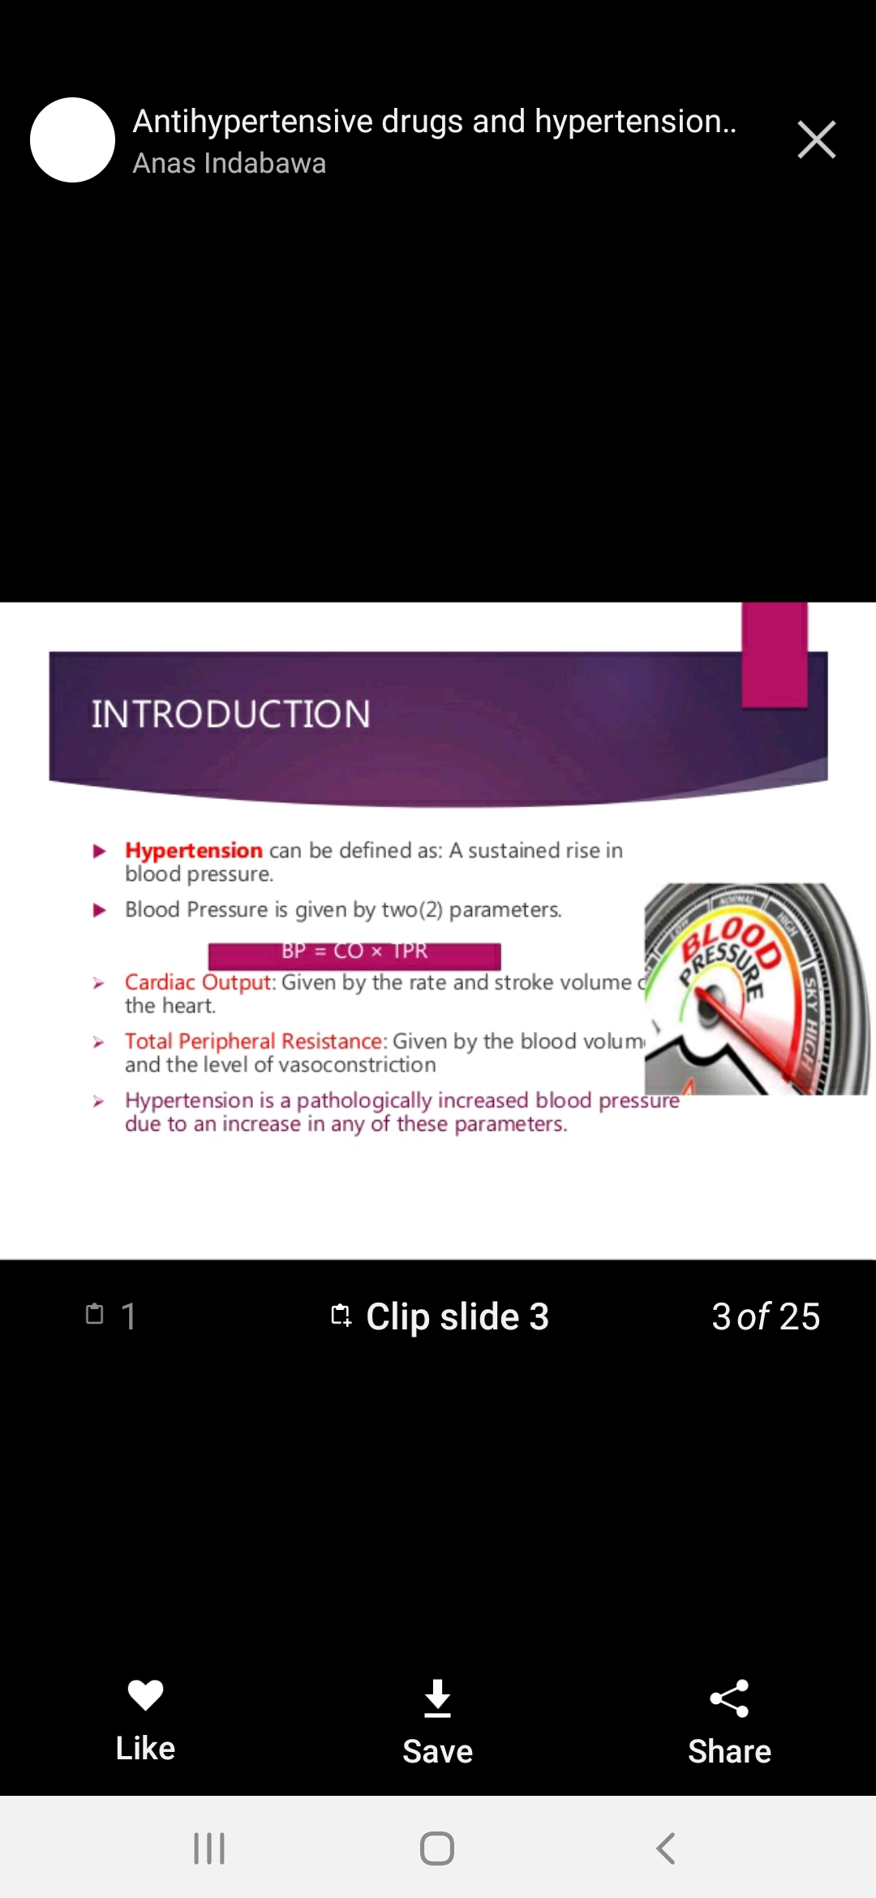
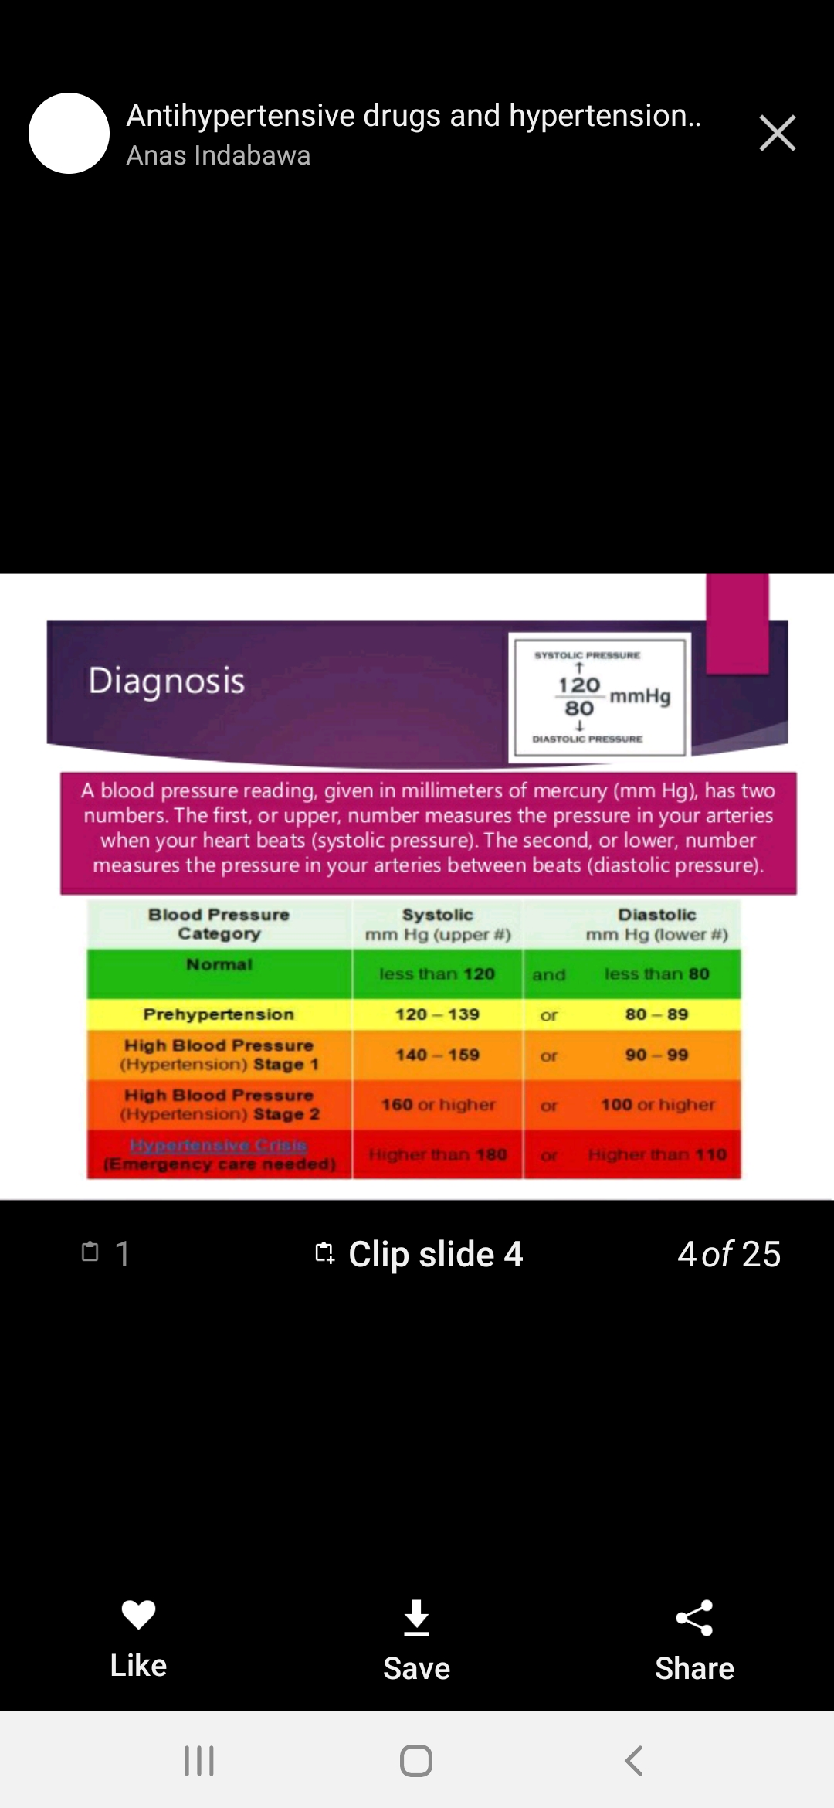
HYPERTENSION
Sustained increase in blood pressure
BP=CO X TPR
CO- Cardiac output
TPR- Total peripheral resistance

Slide 3
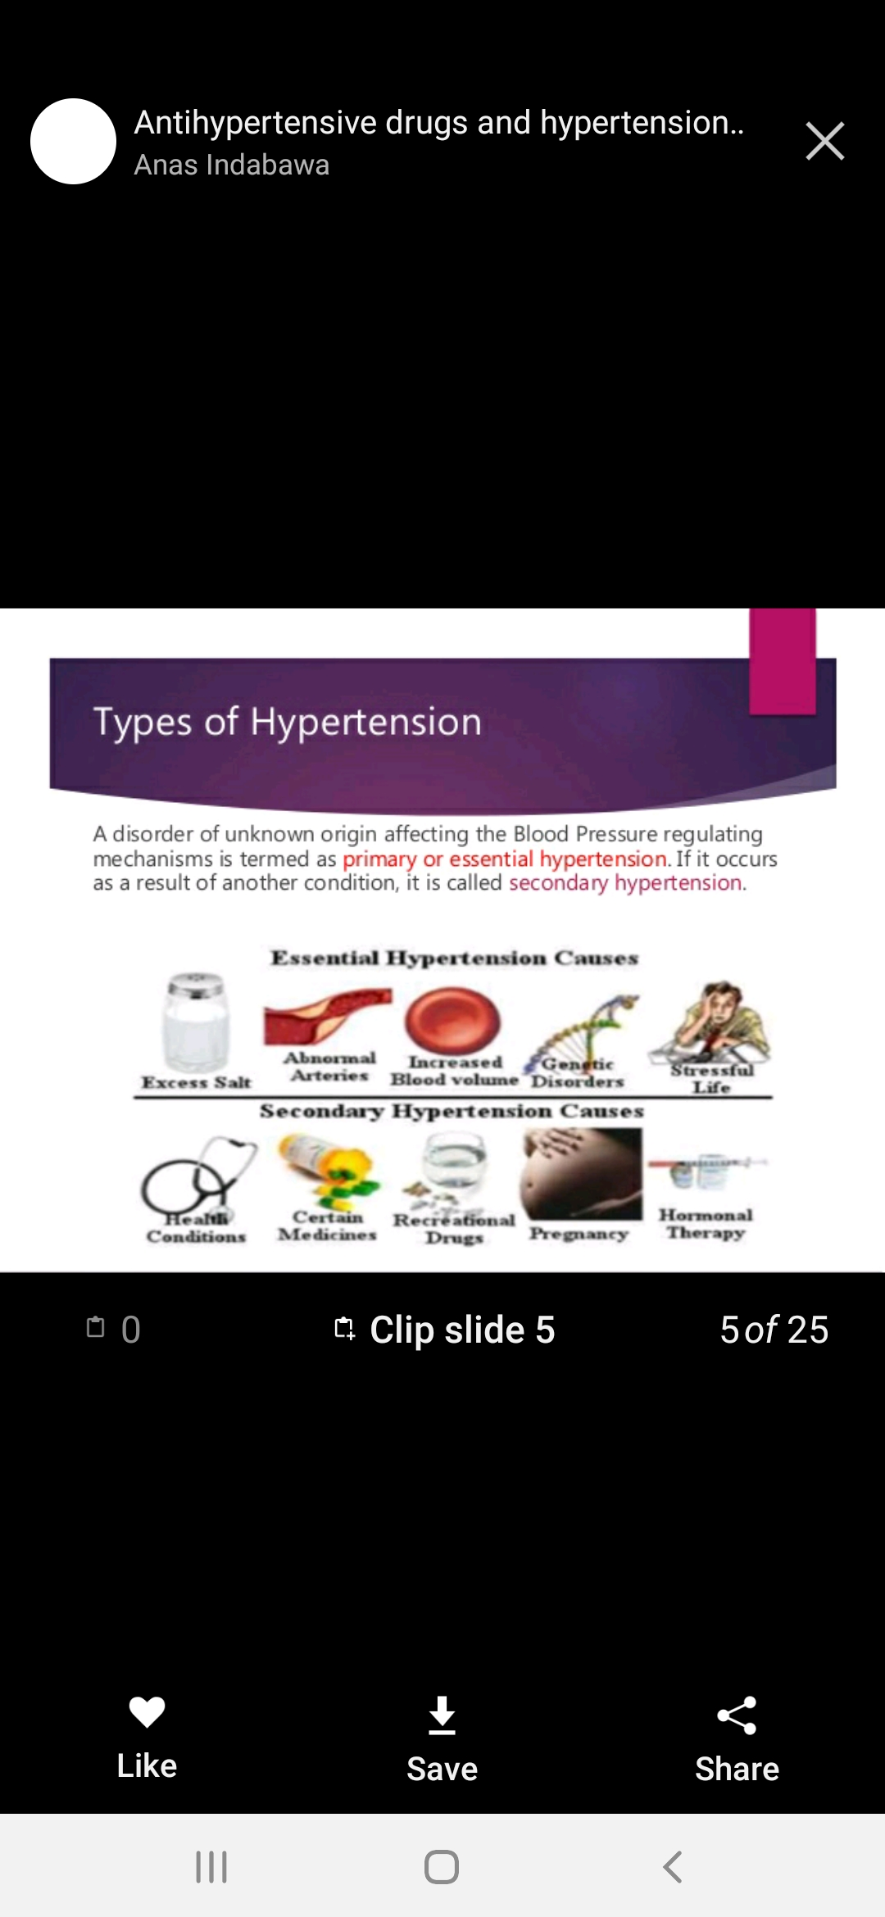
TYPES OF HYPERTENSION
Primary hypertension
Secondary hypertension

Slide 4
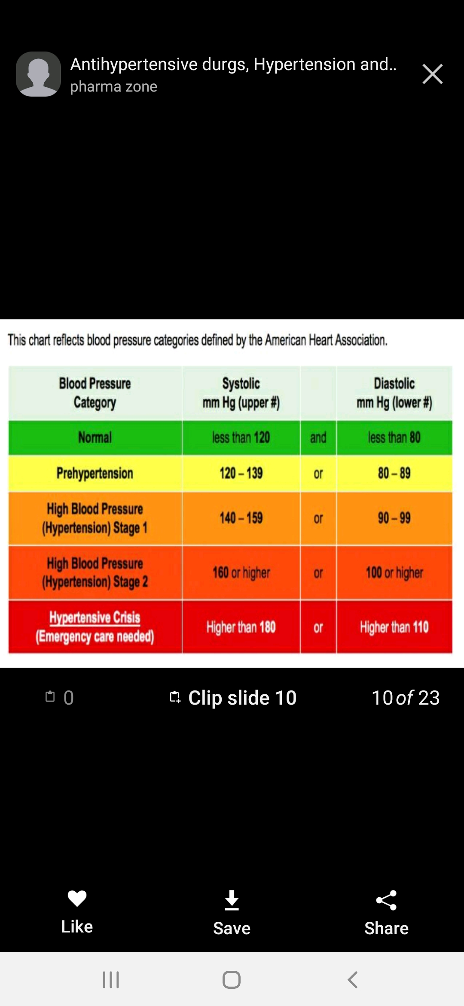
CRITERIA TO DIAGNOSE

Slide 5
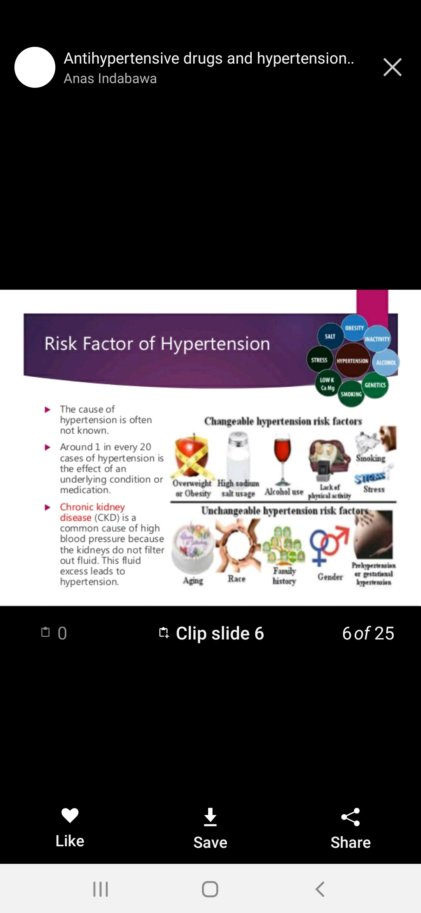
RISK FACTORS FOR HYPERTENSION

Slide 6
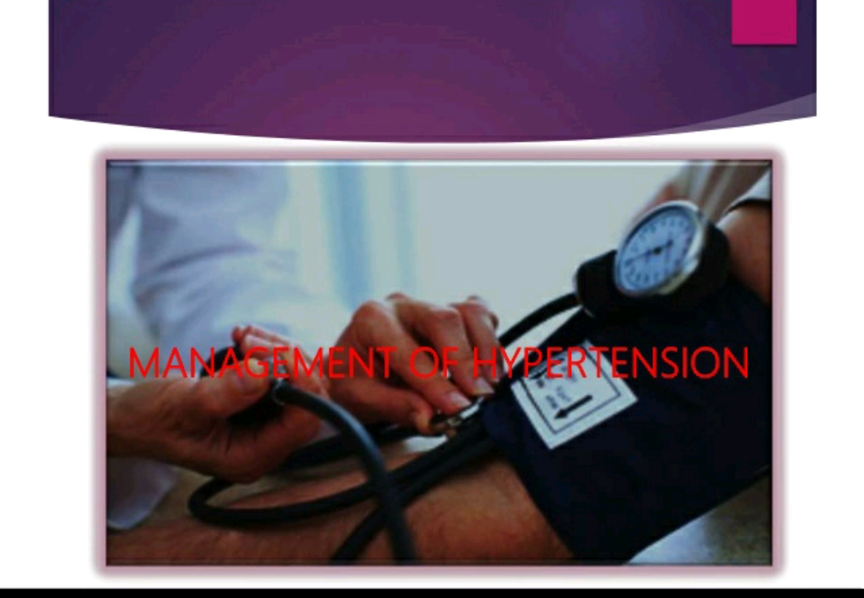

Slide 7
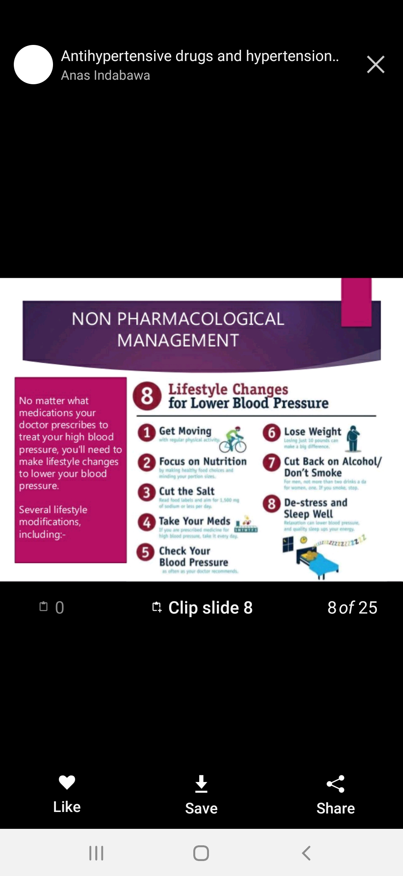
NON-PHARMACOLOGICAL MANAGEMENT

Slide 8
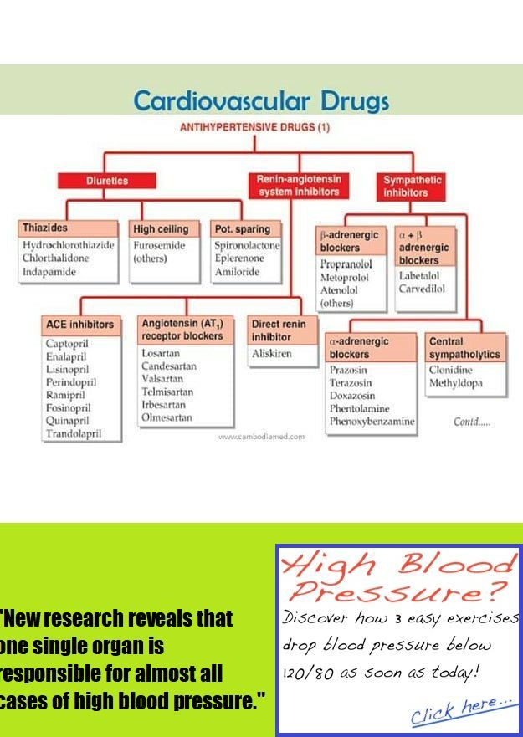
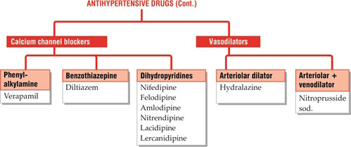
PHARMACOLOGICAL MANAGEMENT

Slide 9
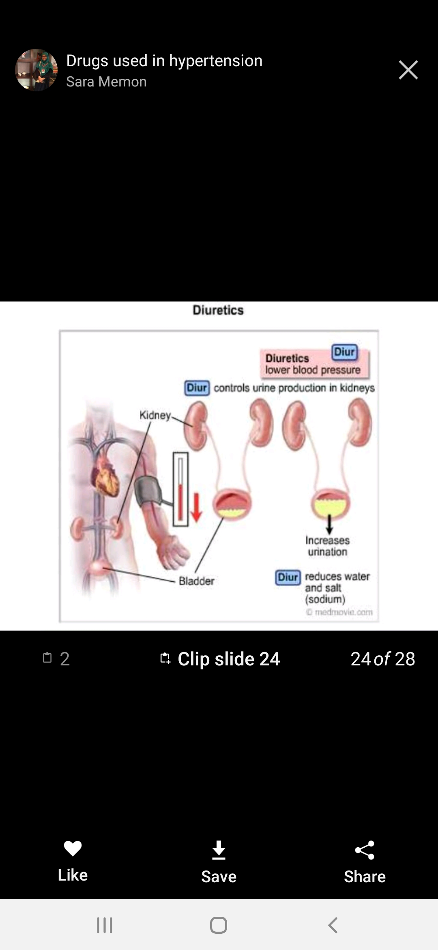
DIURETICS
Drugs that increase urine formation i.e., excretion of Sodium and water in urine.

Slide 10
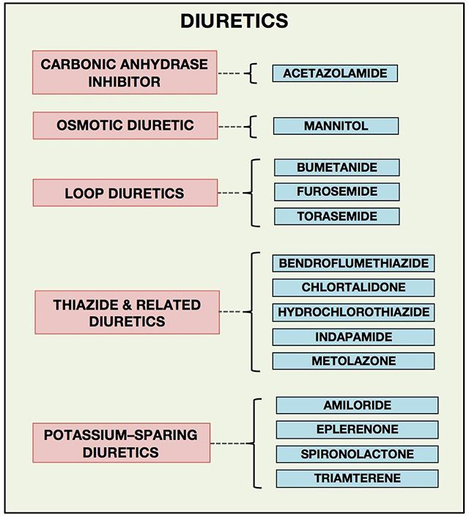

Slide 11
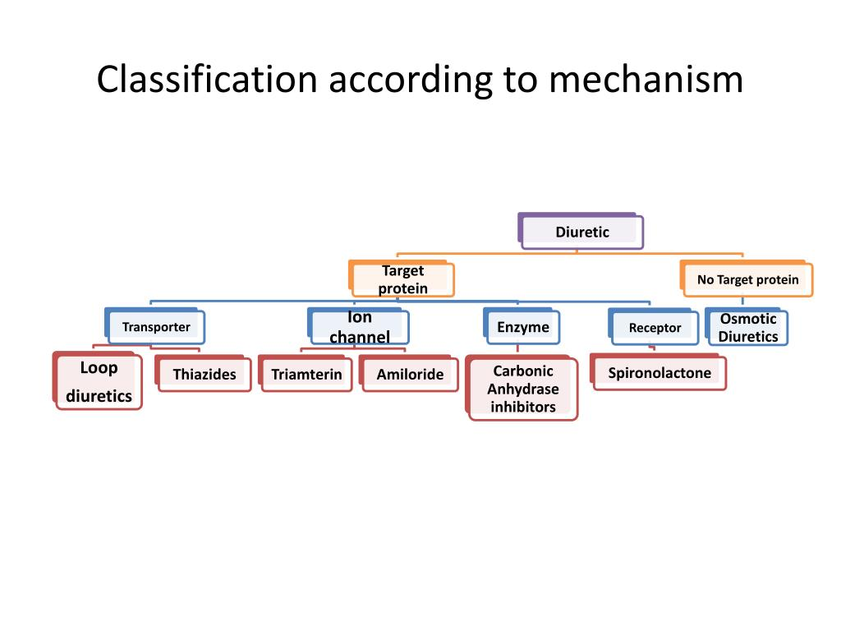

Slide 12
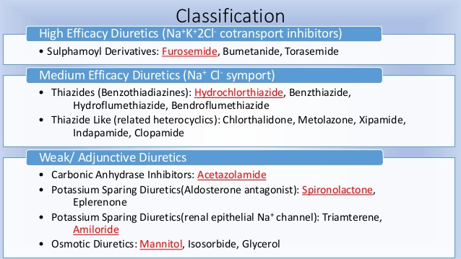

Slide 13
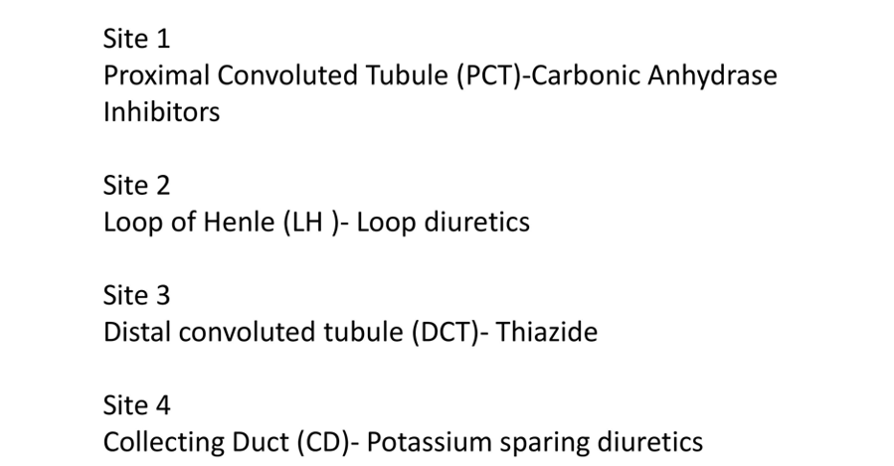
BASED ON SITE

Slide 14
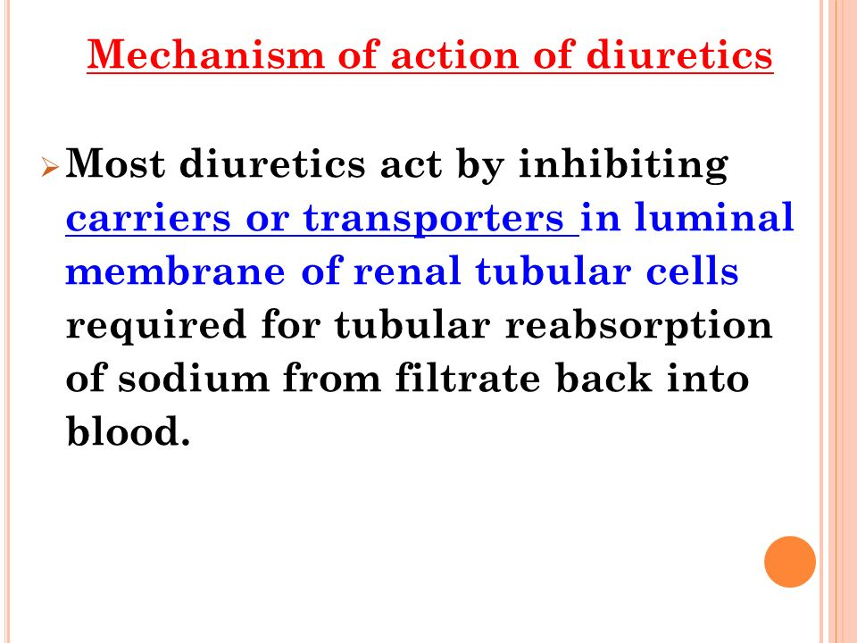

Slide 15
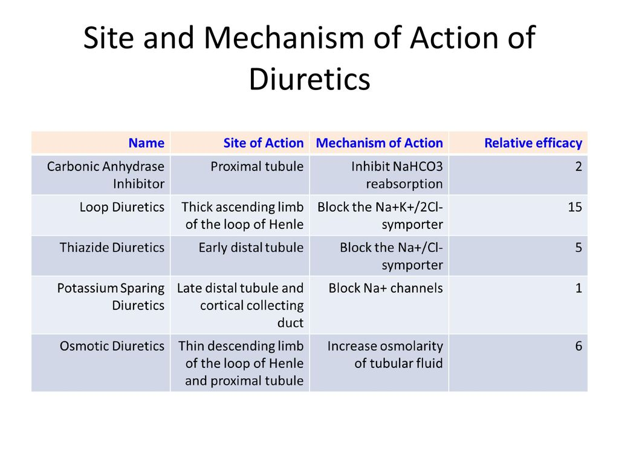

Slide 16
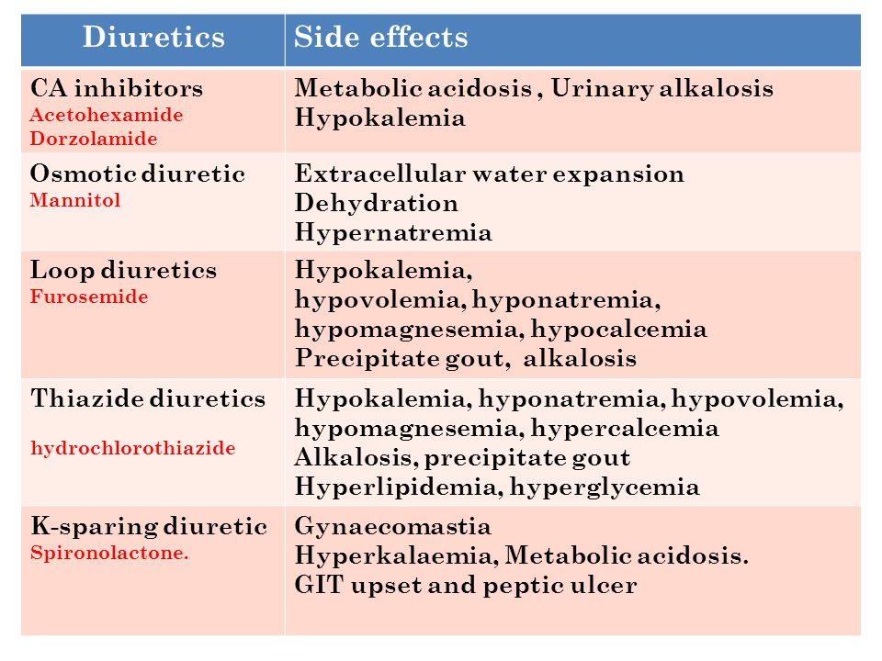

Slide 17
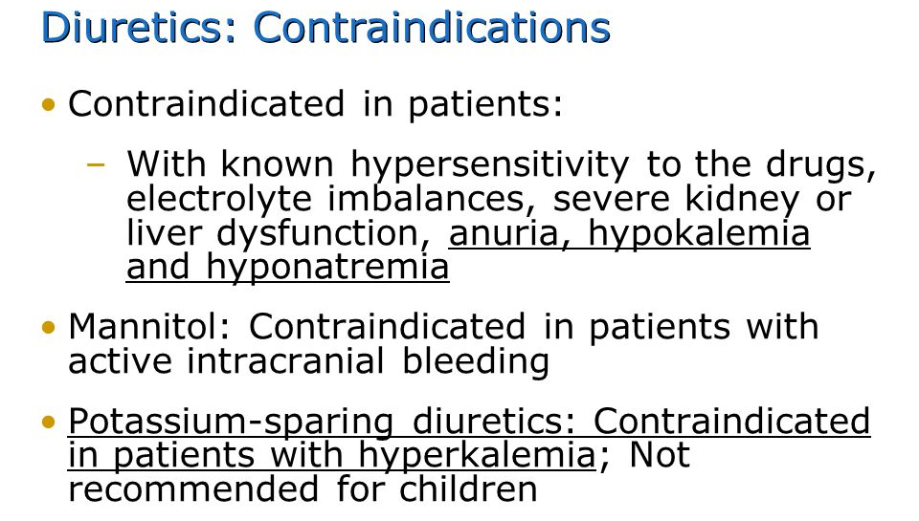

Slide 18
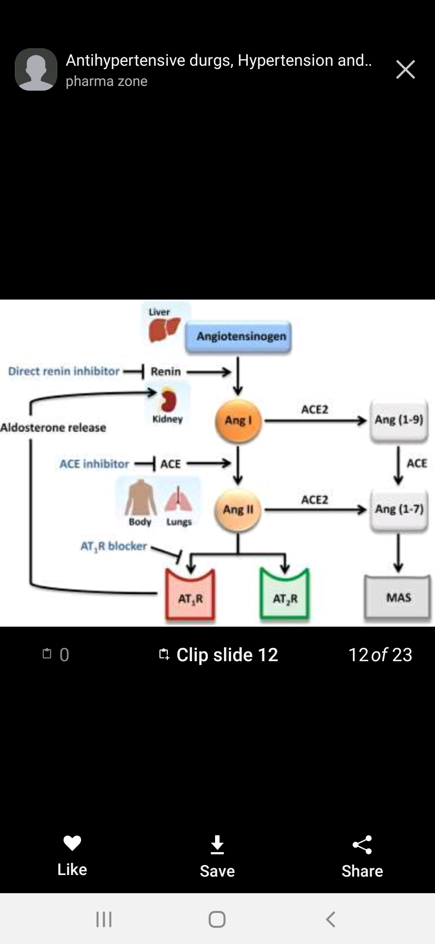
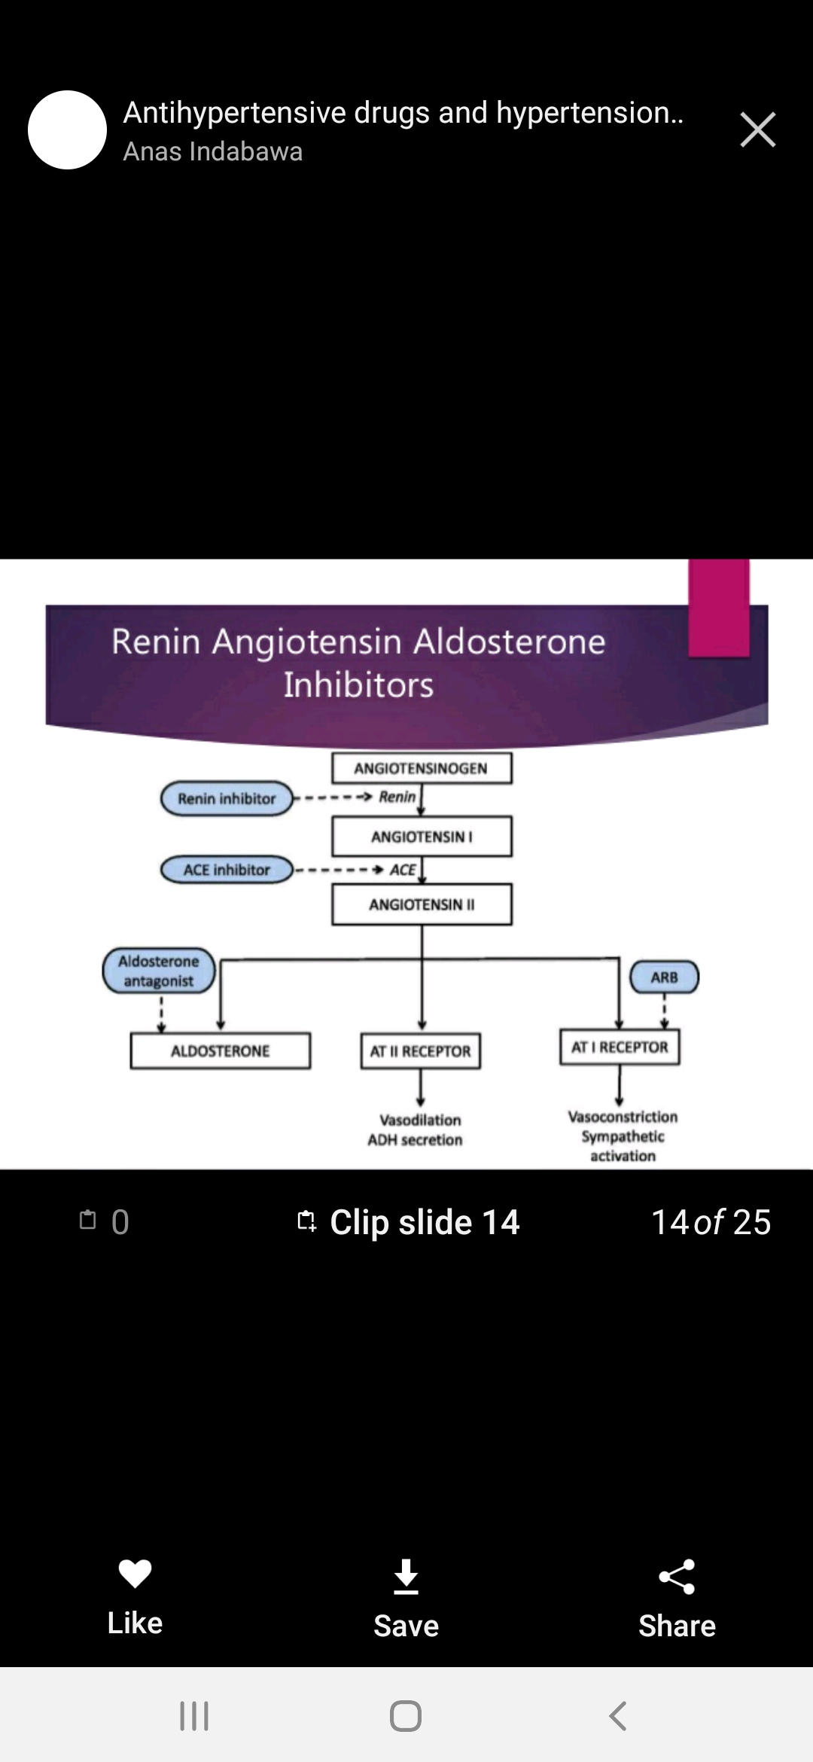
RENIN ANGIOTENSIN MECHANISM

Slide 19
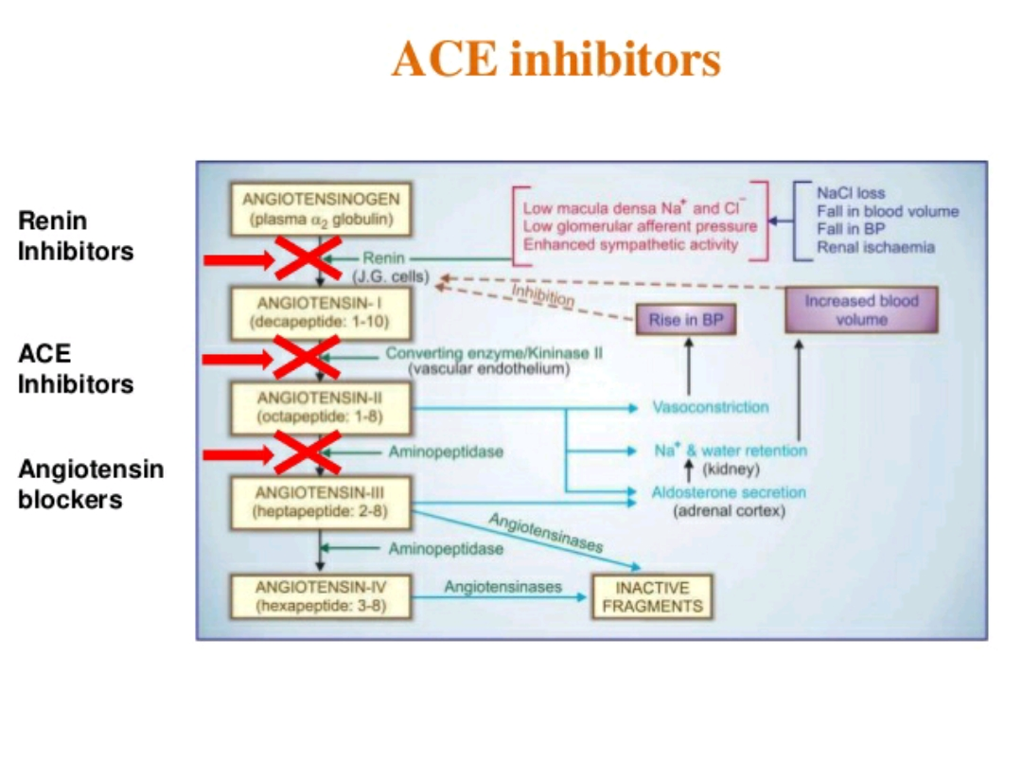

Slide 20
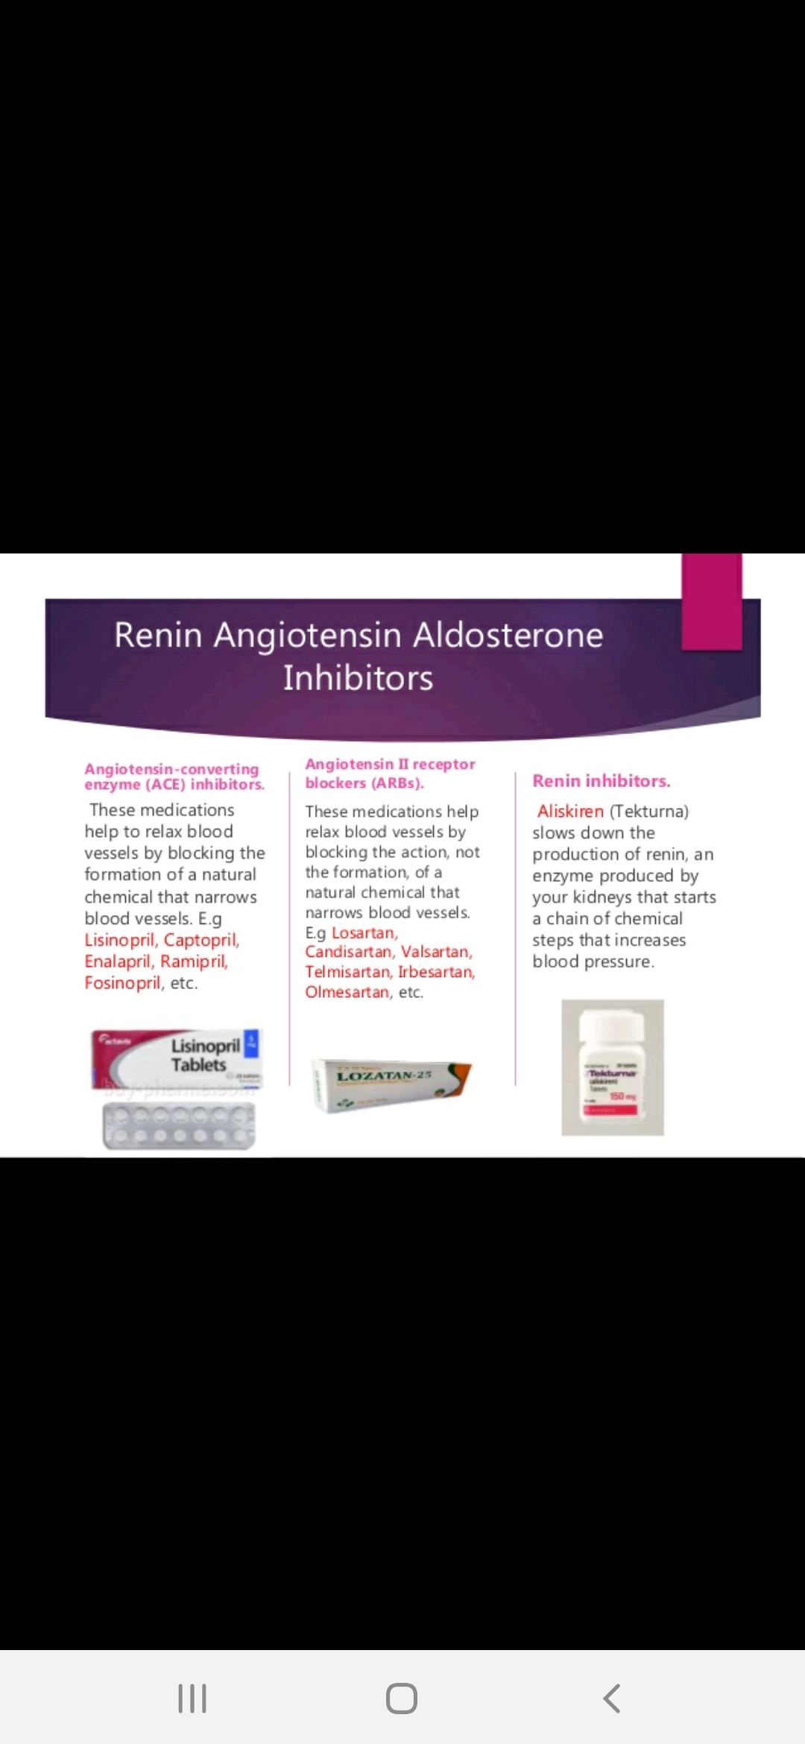
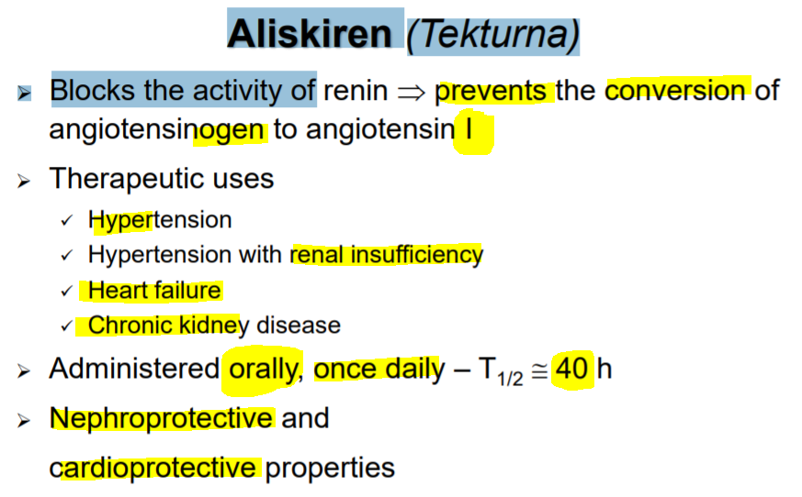

Slide 21
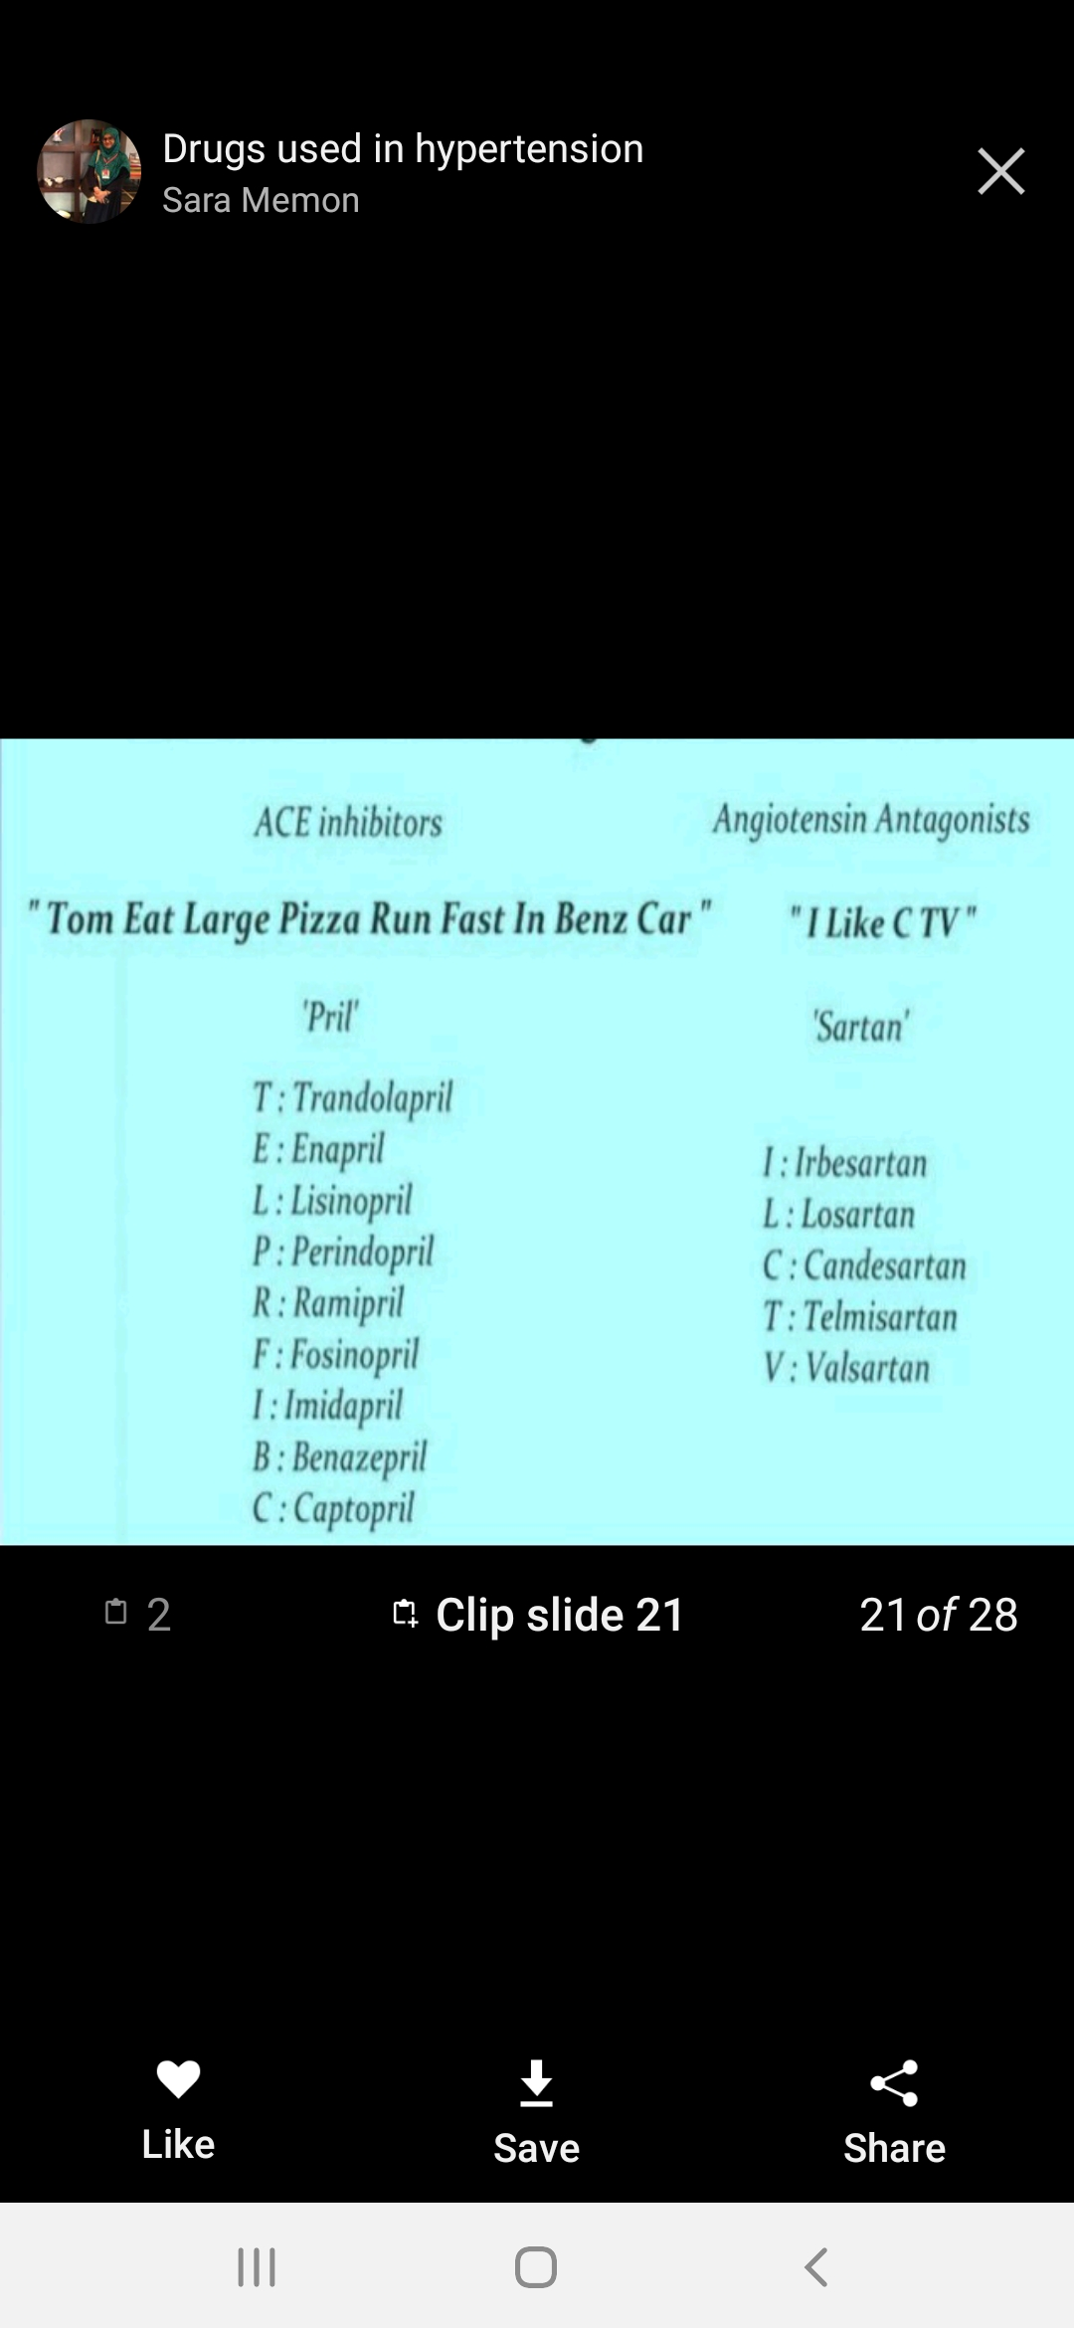
ACE INHIBITORS

Slide 22
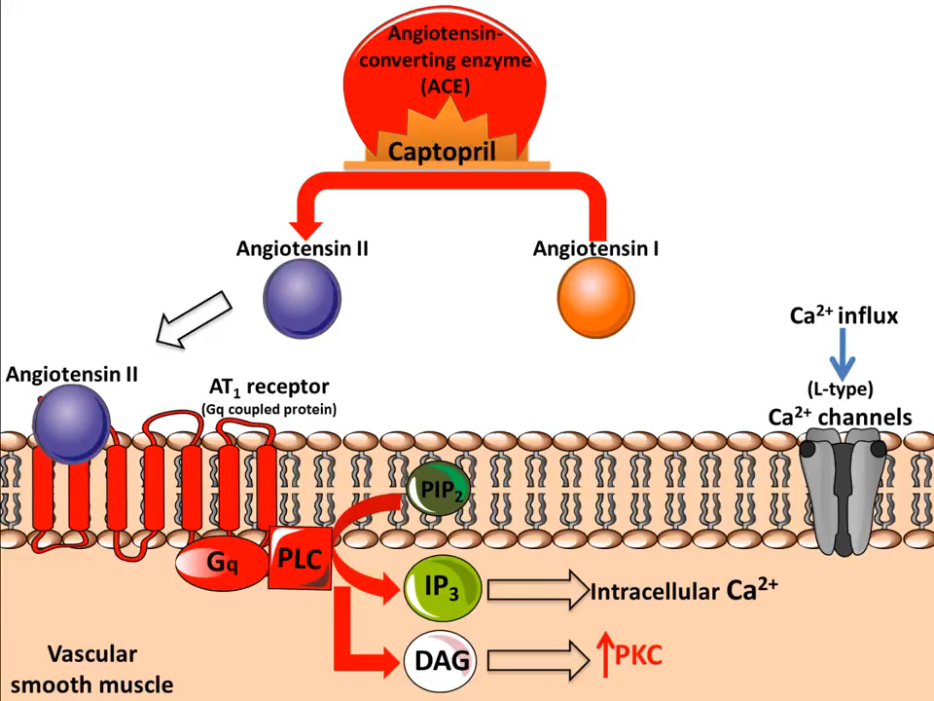
MECHANISM OF ACTION-CAPTOPRIL

Slide 23
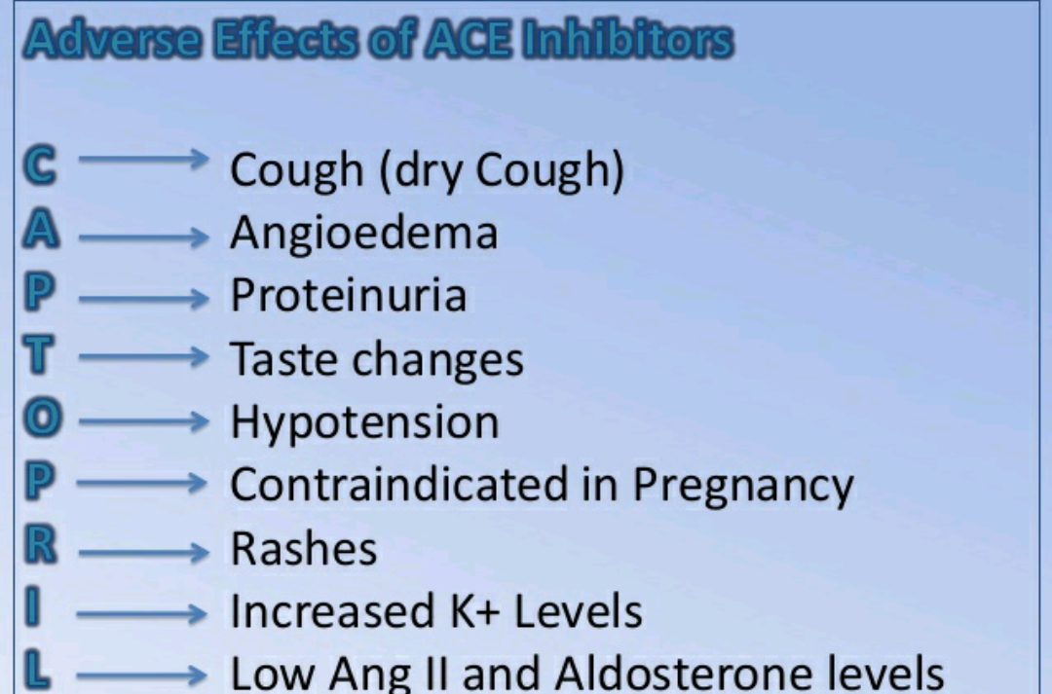

Slide 24
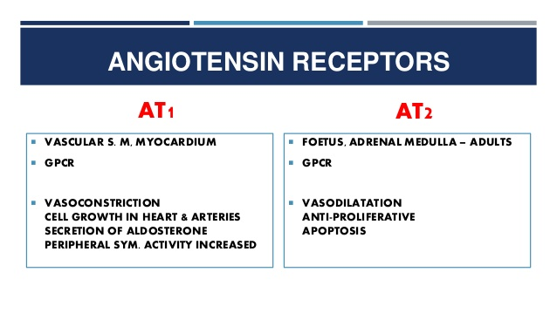
ANGIOTENSIN RECEPTOR BLOCKERS(ARB’S)

Slide 25
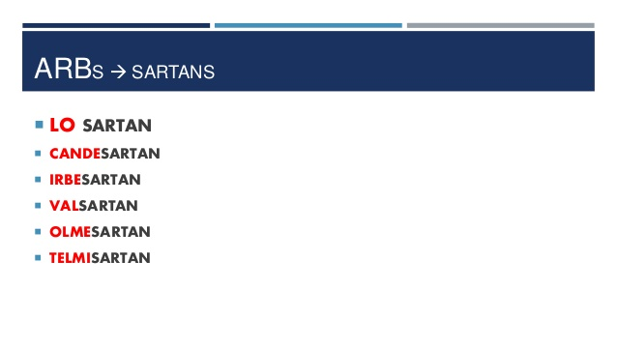
ANGIOTENSIN RECEPTOR BLOCKERS

Slide 26
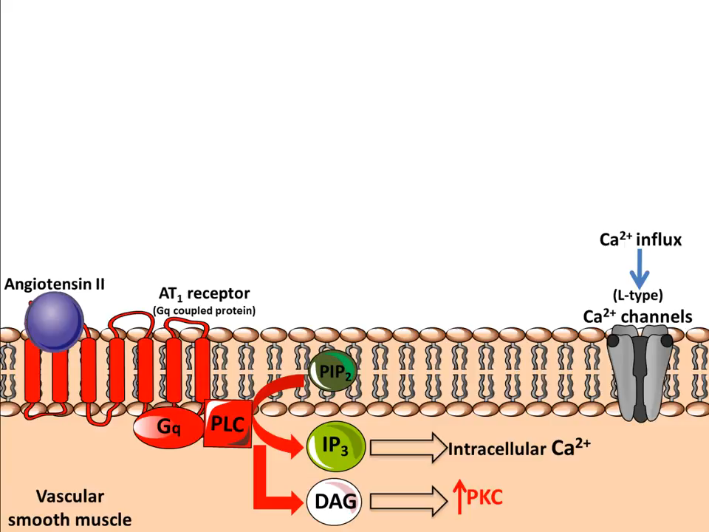
MECHANISM OF ACTION-LOSARTAN

Slide 27
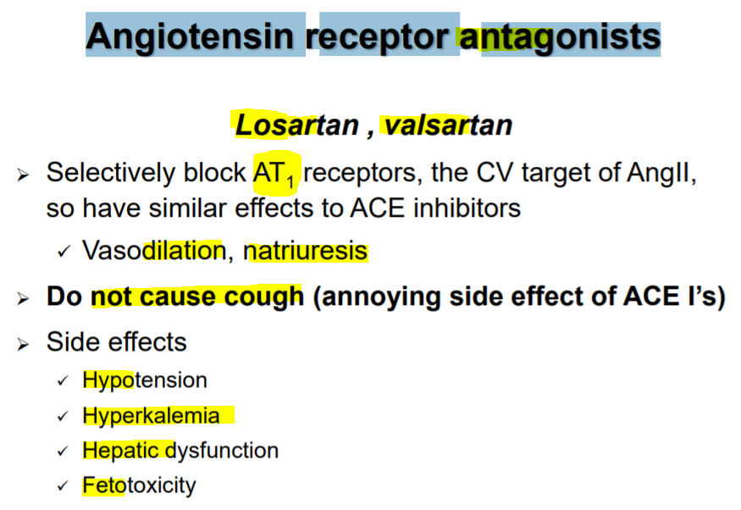
ANGIOTENSIN RECEPTOR BLOCKERS (ARB’S)

Slide 28
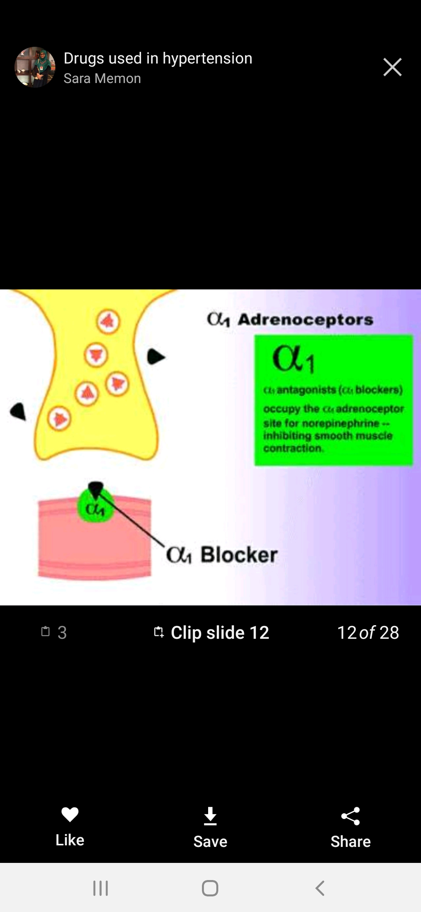
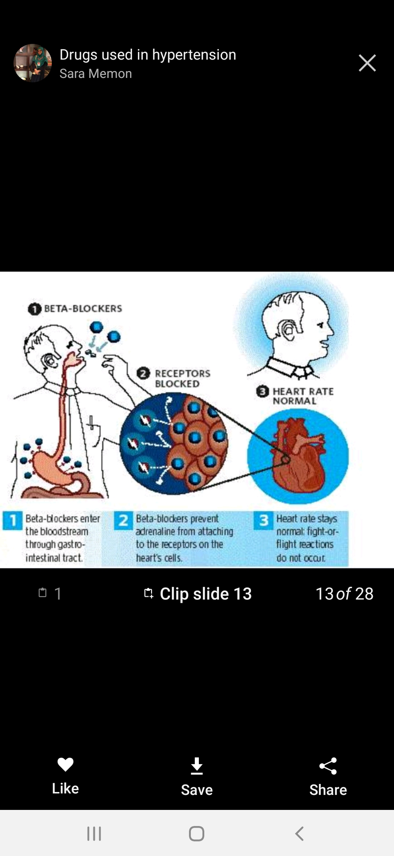
ALPHA AND BETA RECEPTORS

Slide 29
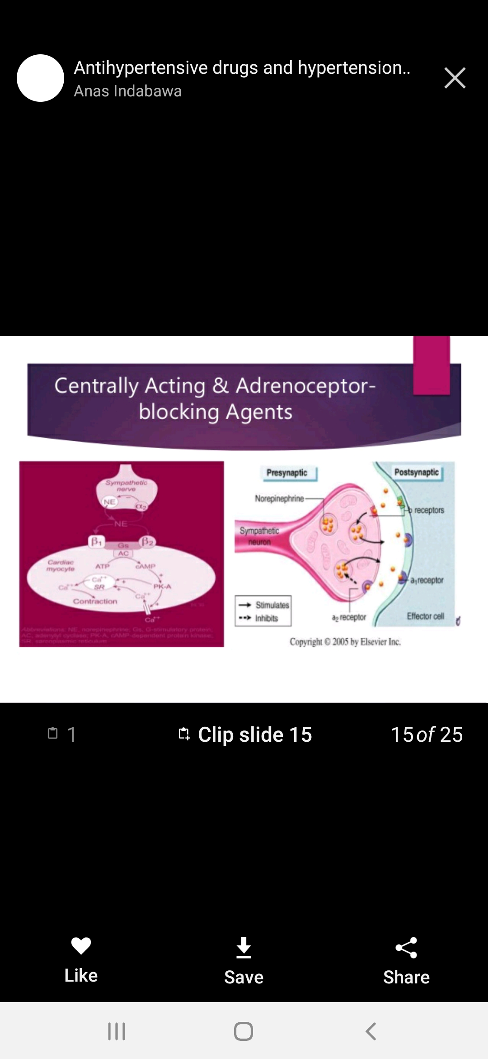

Slide 30
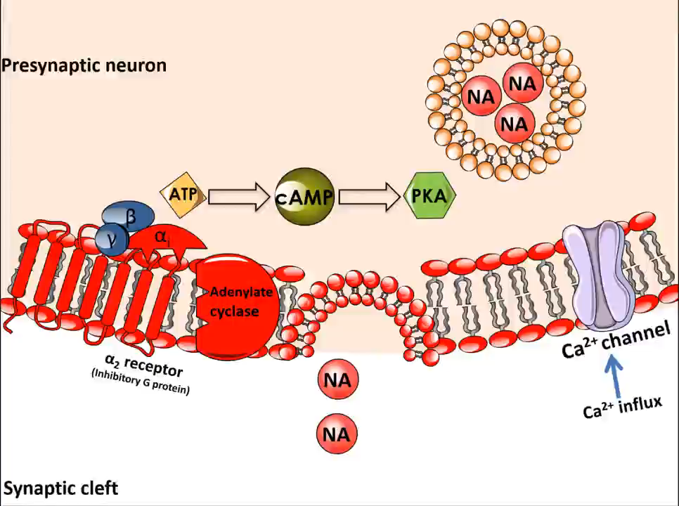
MECHANISM OF ACTION-CLONIDINE

Slide 31
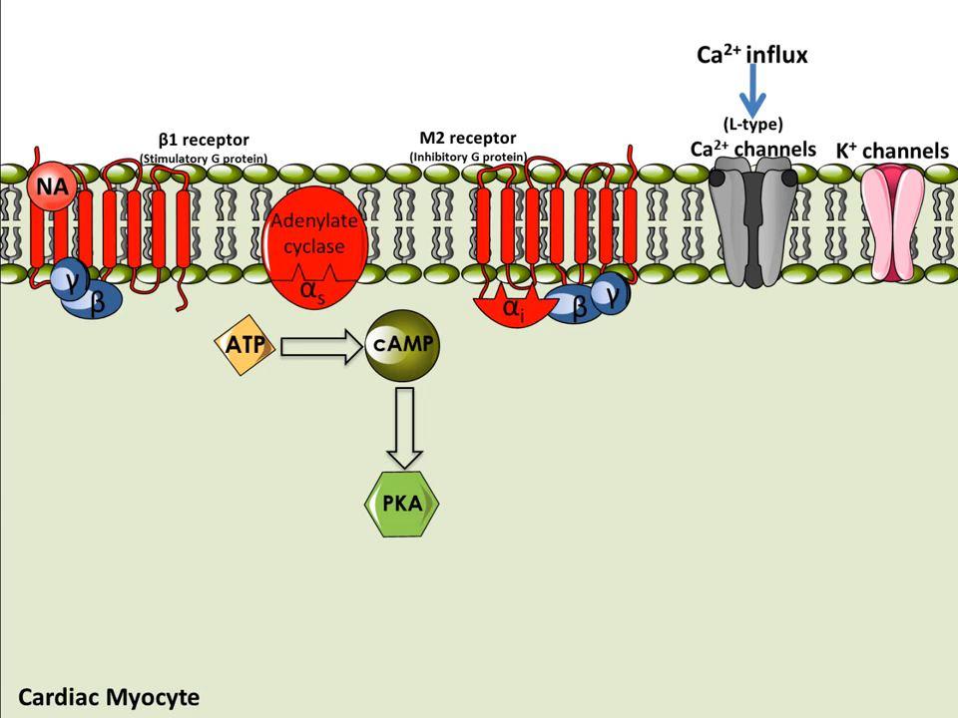
MECHANISM OF ACTION-PROPANALOL

Slide 32
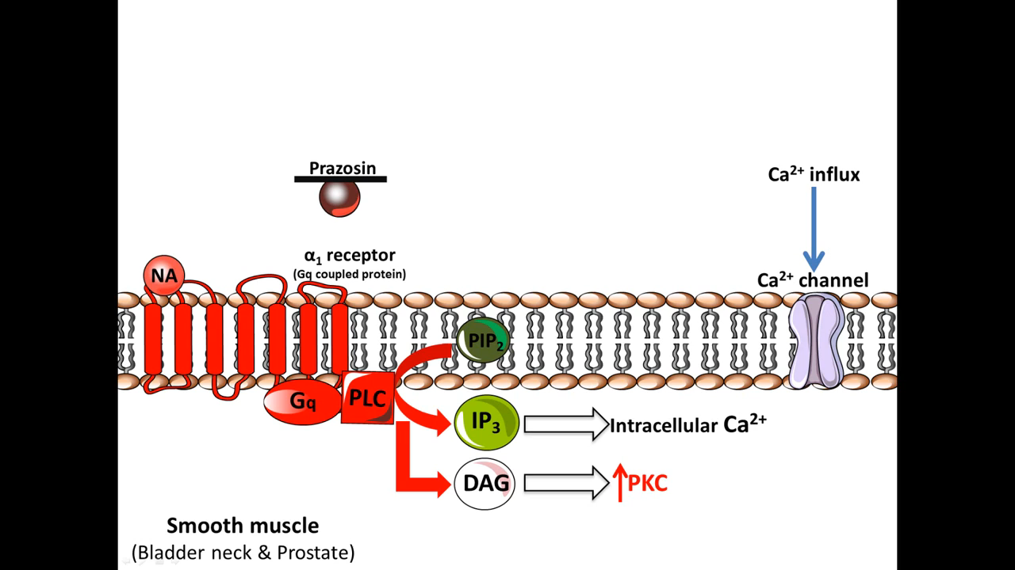
MECHANISM OF ACTION-PRAZOSIN

Slide 33
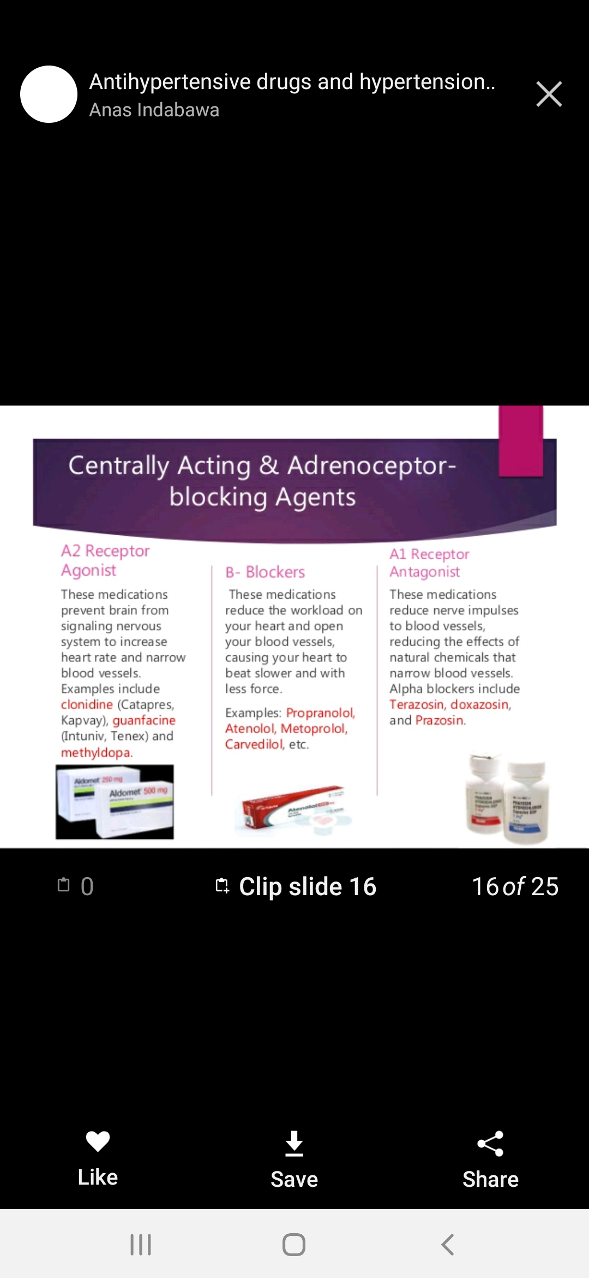

Slide 34
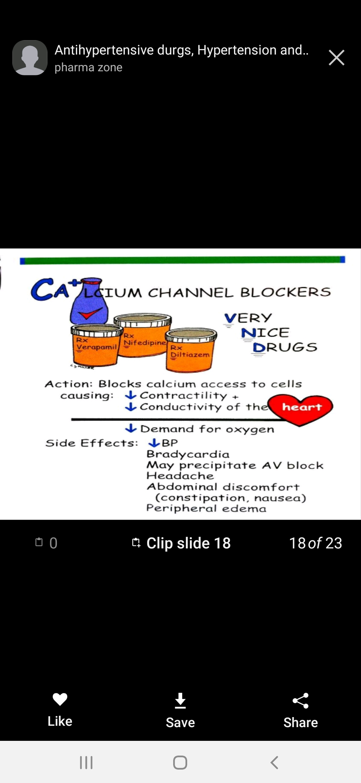
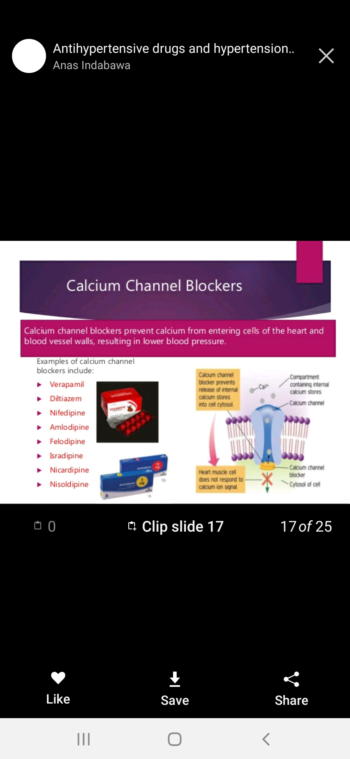

Slide 35
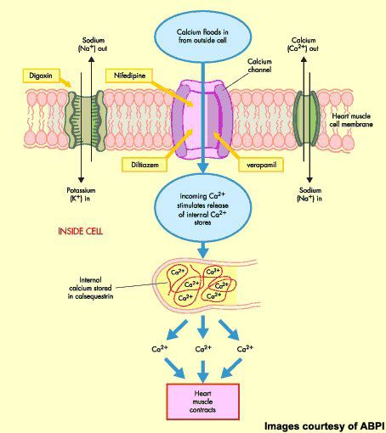
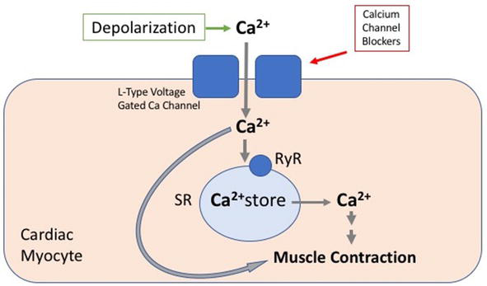

Slide 36
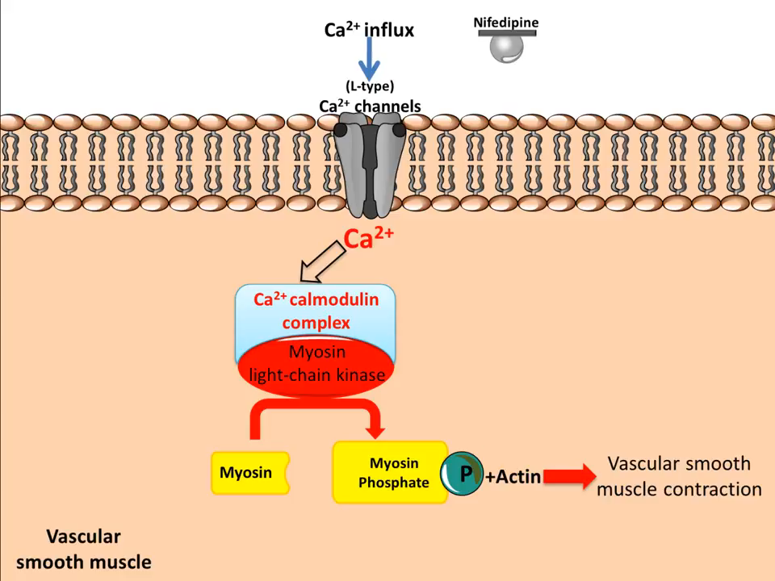
MECHANISM OF ACTION-NIFEDIPINE

Slide 37
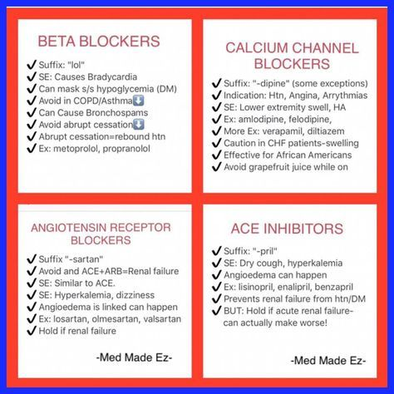

Slide 38
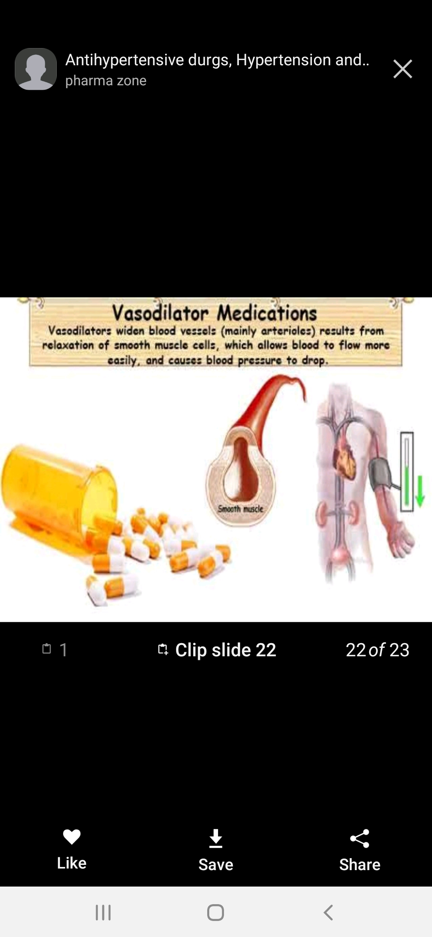

Slide 39
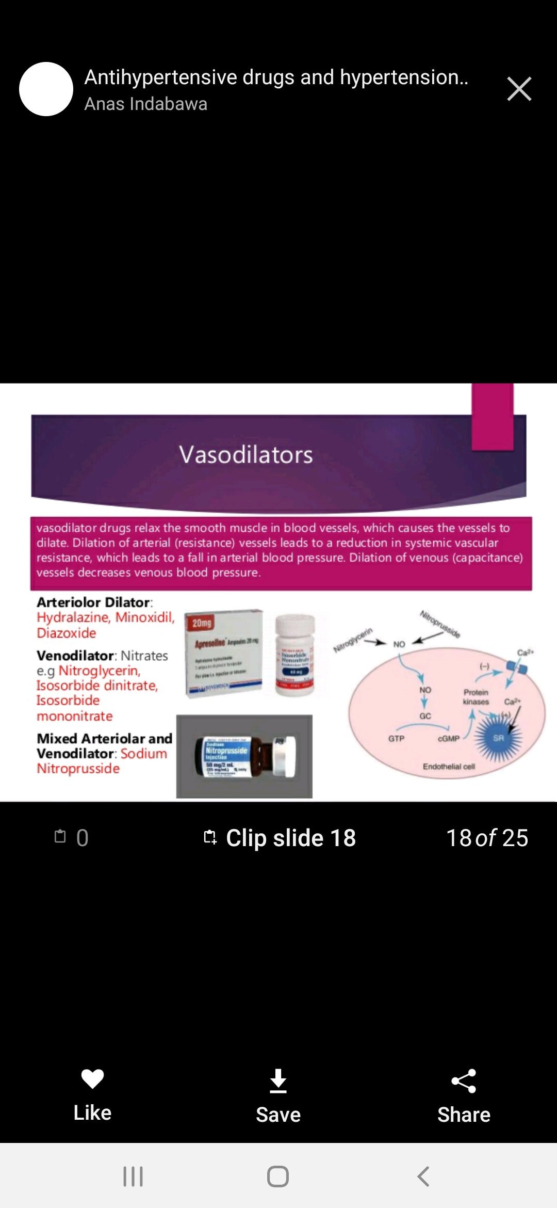

Slide 40
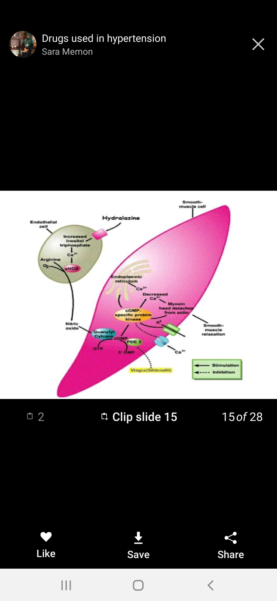

Slide 41
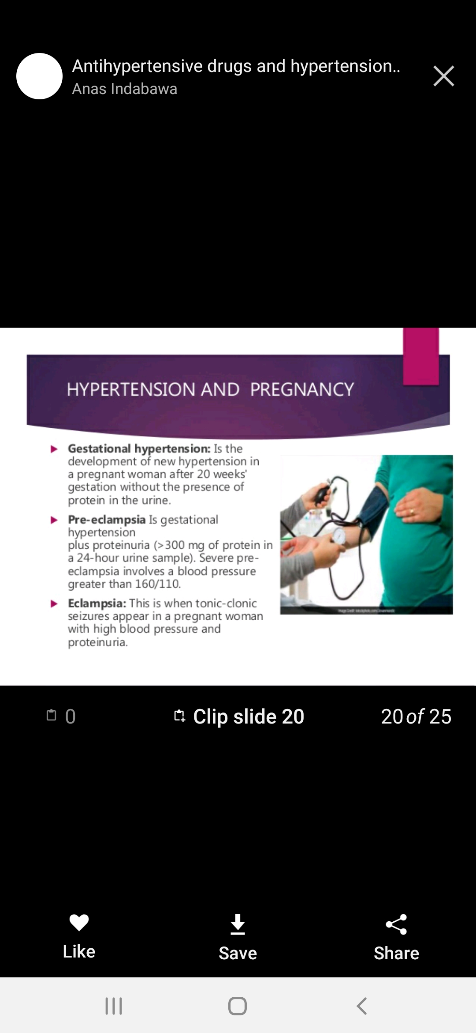

Slide 42
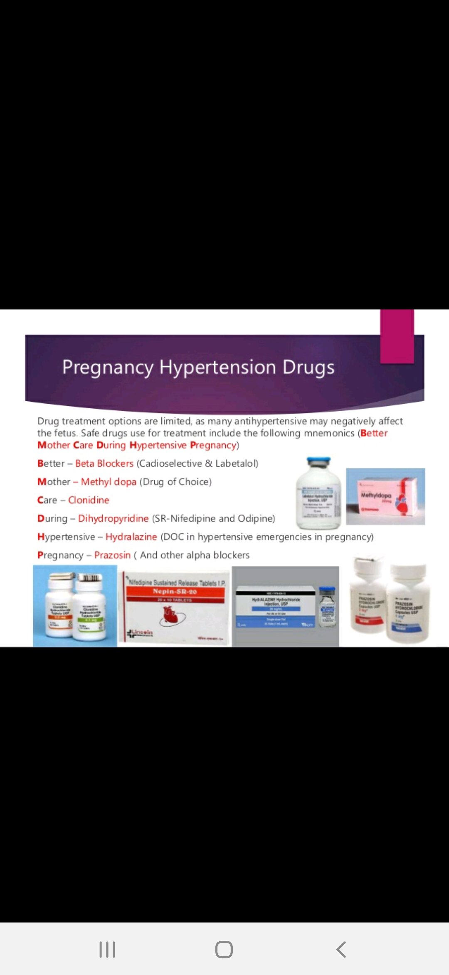

Slide 43
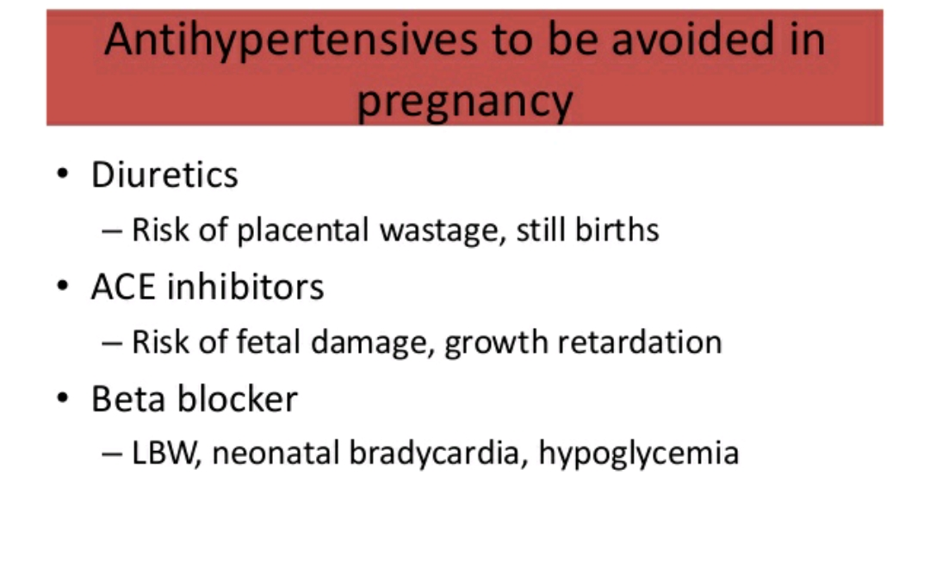

Slide 44


Slide 45


Slide 46


Slide 47


Slide 48







Thank you..!!

